Slide 1
Understanding the Healthy Choices guidelines for drinks in retail outlets
Notes:
This template can be used as a guide to deliver a training presentation for retail outlet staff to increase their skills and knowledge on providing healthier drinks in their retail outlet.
It is intentionally unbranded so you can add your councils branded template.
Speaker notes and slide images are suggested however it is recommended that you tailor your presentation to the needs of the audience and incorporate specific information relevant to your council (e.g. LGA level population data, council plans or strategies).

Slide 2
Today’s session
Topics for today…
Why make healthy food and drink the new normal?
Healthy food retail benefits
The Healthy Choices guidelines
Drinks classifications
Simple swaps to make
Using FoodChecker to identify healthier drinks
Promoting healthier options
Where to get support
Notes:
Introduce yourself and provide an overview of the training.
You may wish to get everyone to introduce themselves and the retail outlet they work for.

Slide 3
Why make healthy food and drink the new normal?
More than one in five Victorian adults drink sugar-sweetened or diet soft drinks daily
Over one third of Victorians daily energy intake is from discretionary food and drinks (high in energy with little nutritional value)
Unhealthy food and drinks are often heavily promoted and easily available in retail settings
Poor diet is a key risk factor for obesity, cardiovascular diseases, type 2 diabetes, and several cancers
Notes:
Sugary drinks and discretionary food consumption (If LGA level population health data is available, you could use this instead)
More than one in five Victorian adults (22.6%) drink sugar-sweetened or diet soft drinks daily.
For young men and women aged 18–24 years 25% drank soft drinks daily, with an average of 700 mL – about two cans per day (assuming 375 mL cans).
In 2014 - For Victorian adults 35% of daily energy intake came from discretionary food and drinks, this increases to 39% for children.
Reference
1. Victoria’s Health: Chief Health Officers Report, 2014, Department of Health & Human Services
Unhealthy foods and sugary drinks are often heavily promoted and easily available in and around settings where Victorians live, work, learn and play such as retail outlets, cafes, sporting clubs and cultural and recreation facilities.
Research shows that the food and drinks that are available for purchase significantly influences people's food and drink choices.
We are surrounded by unhealthy food and drinks and this is a key driver of poor diet, which is a risk factor for obesity, cardiovascular diseases, type 2 diabetes, and several cancers.
References
1. Schwartz MB, Just DR, Chriqui JF, Ammerman AS. Appetite self‐regulation: Environmental and policy influences on eating behaviors. Obesity. 2017;25:S26-S38
2. Global Burden of Disease Risk Factors Collaborators. Global, regional, and national comparative risk assessment of 79 behavioural, environmental and occupational, and metabolic risks or clusters of risks, 1990–2015: a systematic analysis for the Global Burden of Disease Study 2015. Lancet. 2016;388(10053):1659–1724
As people who provide food and drinks in the community, you have an important opportunity to make a positive difference to people’s health and wellbeing.

Slide 4
Healthy food retail benefits
Support health and wellbeing in your community
Be a leader in promoting good health
Opportunities for creating new menus that appeal to customers
There is public support and expectation for healthy food and drinks in community facilities
Notes:
Having a healthier food outlet can help promote messages about healthy eating and healthy lifestyles in your community. If your core business is related to health (e.g sports and rec facility) having healthy food retail will help you meet community expectations about providing healthy food and drinks.
By offering healthy food and drink options, you are demonstrating your organisations leadership and commitment to the health of the community.
Making healthy changes is not just about replacing unhealthy options – its about having the opportunity to create and innovate. You could consider expanding your existing menu or creating new meals and snacks as a way to build ongoing customer interest in your menu.
There is public support and expectation for healthy food and drinks in community facilities – 75% of customers surveyed during the VicHealth Water in Sports project believed that sport and recreation facilities should promote healthy eating.

Slide 5
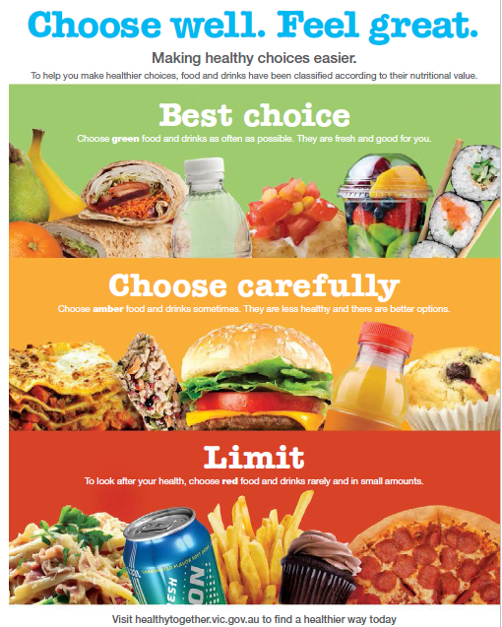
The Healthy Choices Guidelines
Notes:
The Victorian Government has developed the Healthy Choices guidelines to help make sure that healthy foods and drinks are offered and promoted in places like hospitals, health services, sport and recreation centres, parks and workplaces.
The Healthy Choices are in 2 parts
1. the Healthy choices: food and drink classification guide This includes information about how you can determine what healthier foods and drinks are – ie. About what foods and drinks are GREEN, AMBER and RED and
2. separate policy documents for the individual settings as mentioned previously
The guidelines use a traffic light system to classify foods and drinks as GREEN (best choices), AMBER (choose carefully) or RED (limit). As you can see in this example poster on the screen – the traffic light system is not only a good healthy menu planning tool, but a simple and engaging way to communicate to customers what foods and drinks are healthier, why and how to choose them
The guidelines discuss important issues such as: * foods and drinks in retail outlets, vending machines and catering * the importance of organisational policy and contracts about healthy foods and drinks * food and drink advertising, promotion and display * using foods and drinks for fundraising, prizes and give-aways * sponsorship by industry.
The Healthy Choices guidelines can be used by any organisation or business to improve the food and drinks that are available to staff, visitors, customers and other consumers e.g. customers in a hospital retail outlet, staff in a business meetings
The full guidelines can be accessed from the Department of Health and Human Services website. https://www2.health.vic.gov.au/public-health/preventive-health/nutrition/healthy-choices-for-retail-outlets-vending-machines-catering

Slide 6
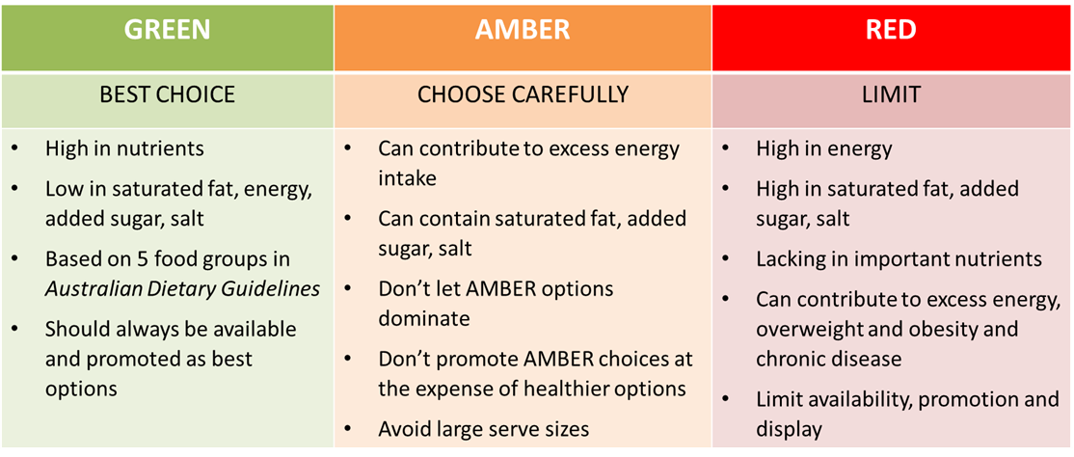
Traffic light classification guide
Notes:
GREEN foods and drinks are the healthiest choices. They are usually:
Good sources of important nutrients
Lower in saturated fat, added sugar and/or salt
Lower in energy (kilojoules)
Higher in fibre
GREEN foods and drinks are based on the five food groups in the Australian guide to healthy eating.
Water is also an important part of the GREEN category.
GREEN foods and drinks should always be available and they should be promoted most prominently as the best choices.
Wherever foods and drinks are offered (e.g. retail outlets, vending machines and catering), at least 50% of choices should be from the GREEN category.
AMBER foods and drinks should be selected carefully and consumed in moderation.
Although AMBER items may provide some valuable nutrients they can:
Lead you to take in too much energy (kilojoules)
Contain saturated fat, added sugar and/or salt.
AMBER foods and drinks may be offered, but should not dominate. They should not be promoted over GREEN choices.
RED foods and drinks are based on the ‘discretionary choices’ in the Australian dietary guidelines.
They are not essential in a balanced diet and can contribute to excess energy intake, overweight and obesity and chronic disease if consumed frequently or in large amounts.
In general RED choices are:
High in energy (kilojoules)
High in saturated fat, added sugar and/or added salt
Lacking in important nutrients such as fibre.
RED foods and drinks should be consumed rarely and only in small amounts. In retail outlets and vending machines, no more than 20% of foods and drinks should be from the RED category. RED foods and drinks should not be provided in workplace catering.

Slide 7
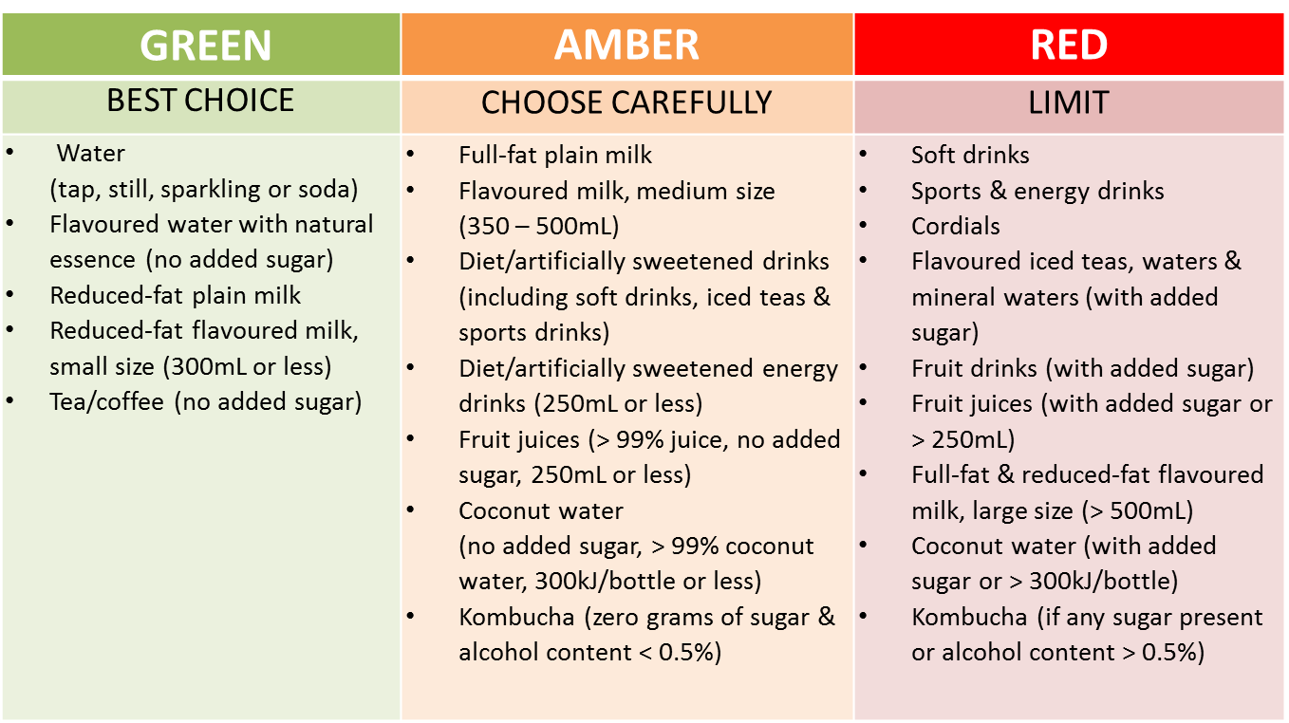
Drinks classifications
Notes:
Here are some examples of classified drinks.
Increasing the availability of healthy drink options like water and limiting availability of sugary drinks in fridges subtlety nudges customers to purchase healthier drink options.

Slide 8
Swapping for healthier drinks
Notes:
With drinks, there are always healthier options to select.
By simply choosing a healthier version of the drink you are selling you can make your drinks fridge healthier.
For example:
Continue to offer an item but in a smaller serving size (e.g. Swap the 350ml bottle of no added sugar orange juice for a 250ml bottle)
Continue to offer an item in the same brand but an artificially sweetened version (e.g. Swap the regular sports drink for the diet version with no sugar)
Continue to offer a similar item in the same brand but with no added sugar (e.g. Swap the mineral water with sugar for a water flavoured with essence only)
As you can see the changes don’t have to be huge – even small changes can make a menu much healthier.

Slide 9
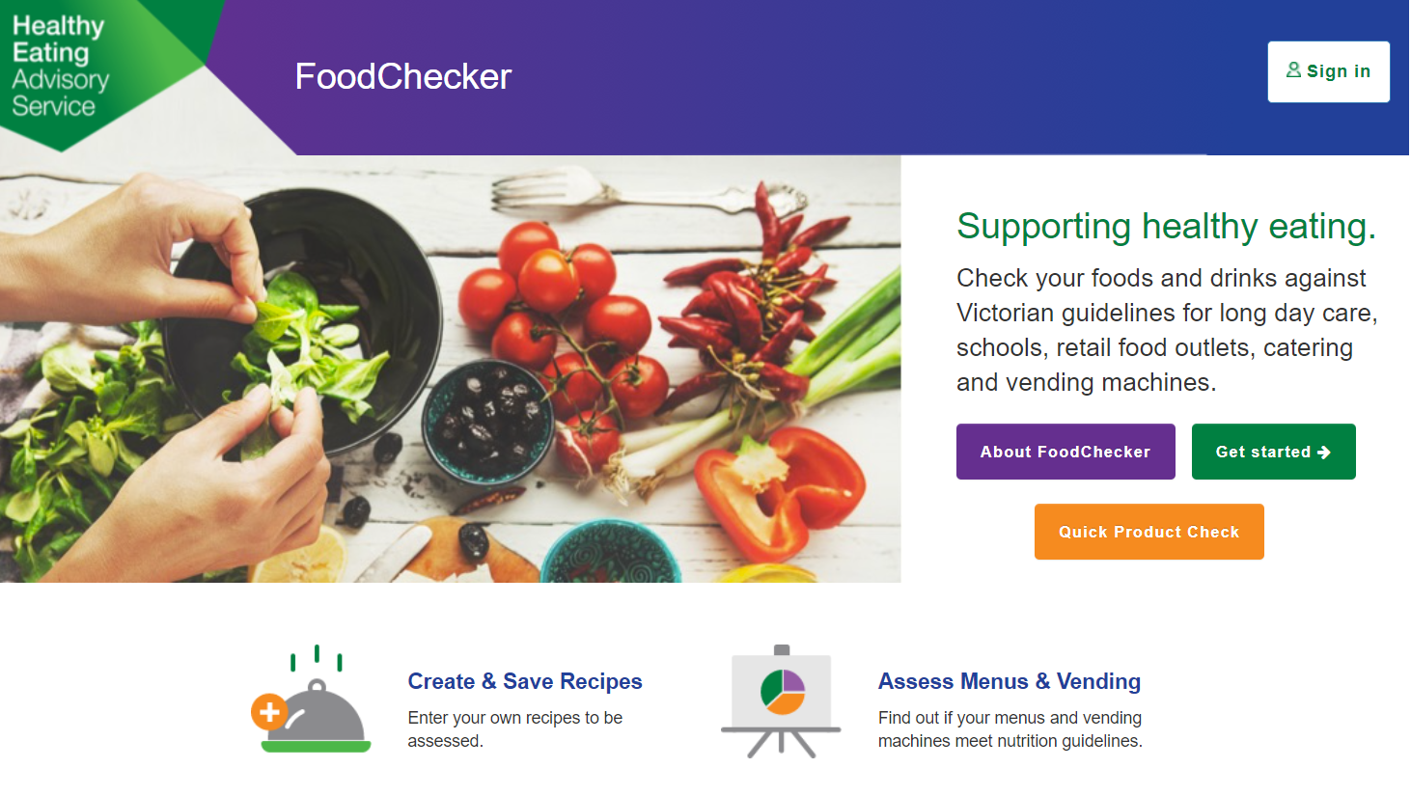
FoodChecker: online assessment tool
Notes:
The Healthy Eating Advisory Service (known as HEAS) has developed an online tool that allows you or anyone in your organisation to assess their menu, products or recipes against the Healthy Choices guidelines.
You can also assess individual products, even if they're not in their database.
You will get immediate feedback on the screen and be able to download a report. This tool enables anyone to assess their menus, recipes and products. It is also a useful tool to plan healthier menus as users will be able to store their recipes and menus in their accounts for future use.
You can use FoodChecker to complete assessments of your drinks fridges to work out the percentages of GREEN, AMBER and RED drinks available.
You can also look up drink classifications or search for new healthy drinks to stock - we will go through how to do this today.
You can use the quick product search to find out a classification without logging in – however it is recommended to create an account if you intend to use the tool on a regular basis.

Slide 10
Starting an assessment
Notes:
Register yourself as a FoodChecker user.
When first starting an assessment you’ll be asked your facility’s details again - however this should autofill so it won’t take too long!
When entering the number of staff and visitors, please estimate to the best of your ability if you don’t have exact numbers.
Visitor/customer numbers are per day so if you only have per month/year data you’ll need to work this out.
Number of sites refers to the locations that this assessment applies to – for example, if the menu is only in one café, the number of sites will be one.
If the same menu is used across multiple cafes then enter the total number it applies to - for example, the same menu is in three different kiosks across an organisation, the number will be three. The information will be recorded against the organisation you first entered but we will also keep a record against the other site names also.

Slide 11
Start assessment dashboard
Notes:
Pictured here is the dashboard of options for the different types of assessments you can do.
On the left is the option to do a full menu assessment for a retail food outlet, such as a café or kiosk, or a catering menu.
On the right are the options to do a recipe assessment or product assessments.
Select ‘Search and assess products’.

Slide 12
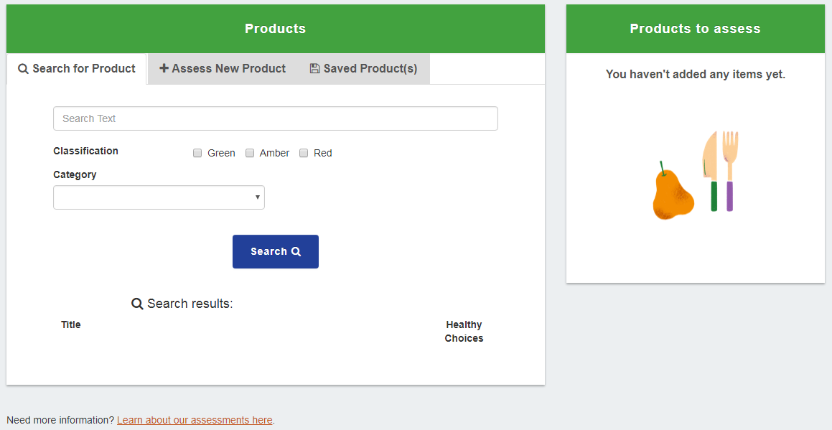
FoodChecker product assessments
Notes:
There are 2 options for completing a product assessment.
Search for existing products from our database that are already classified.
Assess new products that aren’t in our database. You can also save these products for use later in a menu assessment.
To search for a product, simply type the name into the search box.

Slide 13
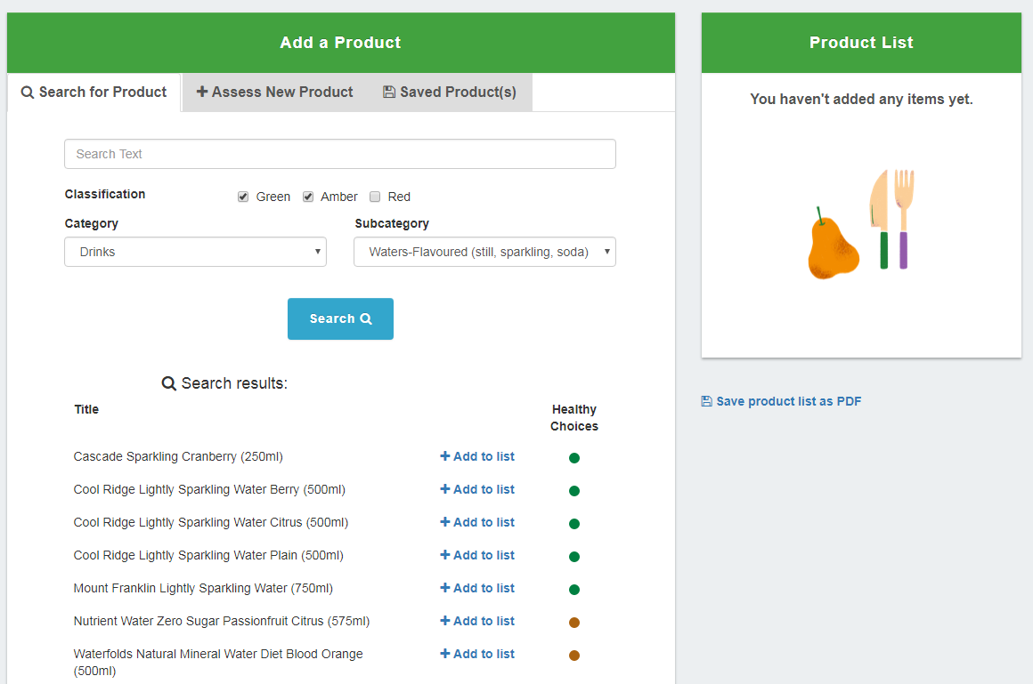
FoodChecker product assessments
Notes:
Or if you want to see the classifications of a range of similar products, try searching ‘popcorn’ or ‘tuna’.

Slide 14
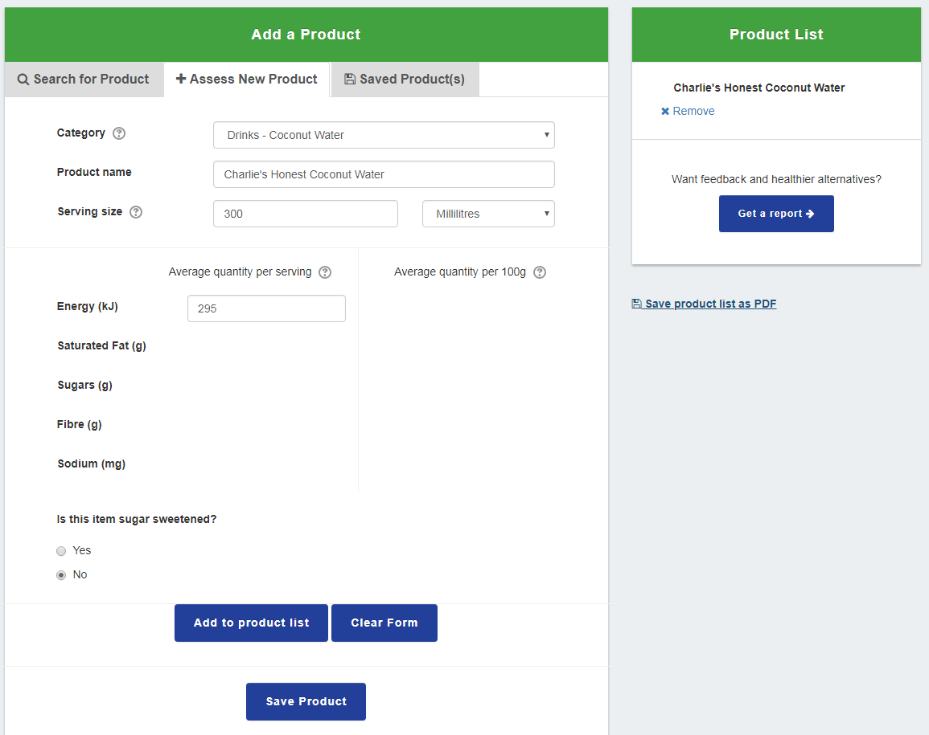
FoodChecker product assessments
Notes:
To assess a product not in the database, there is some information you need to enter.
This information is generally from the product Nutrition Information Panel (NIP) so it can be compared to the Healthy Choices NIP criteria.
Or you may be asked a few qualitative questions about the product.
Make sure you select the correct category of the food or drink so it is assessed against the correct criteria.
Enter all the information required and click ‘Add to product list’.
Once you added all the products you want to assess, click ‘Get a report’.

Slide 15
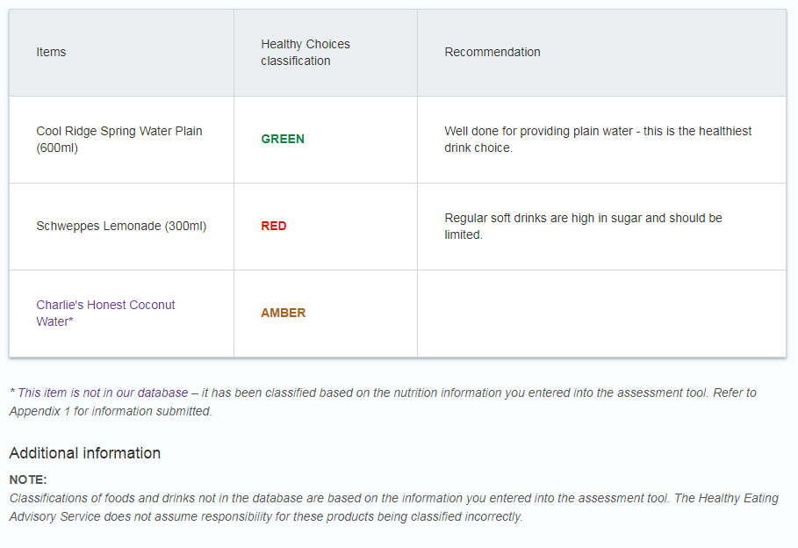
FoodChecker product assessments
Notes:
Products with a RED rating will feature recommendations of a healthier type of product to choose in that category.
Please note the additional information about products that are assessed not from the HEAS database.

Slide 16
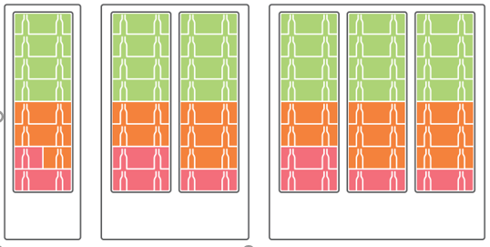
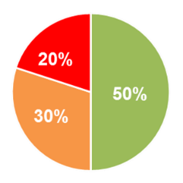
Healthy drinks fridge – limit RED drinks
Notes:
For those of you who are implementing the nudge to limit RED drinks, these are the targets you are aiming for:
At least 50% GREEN drinks
No more than 20% RED drinks
The rest of your percentages made up by AMBER drinks
RED drinks must be displayed in the least prominent areas, and GREEN drinks in the most prominent. This means having RED drinks on the lowest shelves of the fridge, and the GREEN drinks at eye levels
This layout is an example of how you might stock different fridge sizes.
If the fridge is in a location or facility that is frequented by children, you may wish to switch the planogram around so RED drinks are on the highest shelves, so they are not at eye level for children.
These placement decisions will be determined once you start working on these changes.

Slide 17
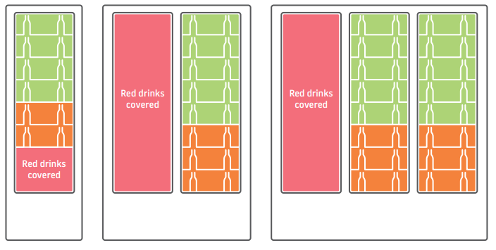
Healthy drinks fridge – RED off display
At least 50% GREEN
Notes:
For those of you who are implementing RED drinks off display, these are the targets you are aiming for:
All RED drinks are removed from the fridges and placed in another fridge out of customers’ sight. Only GREEN and AMBER drinks remain.
Or, all RED drinks remaining in the fridge are covered up so they are not visible to customers. Some examples on the slide include covering up the bottom rows of the fridge where the RED drinks are, or moving all RED drinks to one side of the fridge and covering that whole side.
At least 50% GREEN drinks are available of those visible to customers.
This layout is an example of how you might stock different fridge sizes.
If you are covering up the RED drinks with a decal, options may include plain decals with no pictures/branding, decals featuring your facility’s branding, or posters promoting/encouraging people to consumer water.
These options may be discussed with your facilities once you start working more closely with them. Should not be advertising of RED products or associated brands.

Slide 18
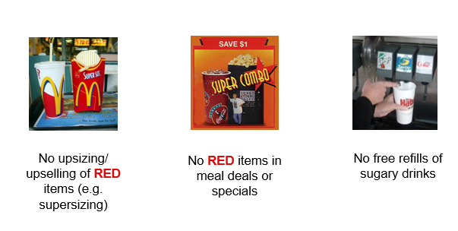
Display and promotion principles
Notes:
Healthy Choices also includes some display and promotion principles to addressed in retail outlets, in order to promote healthy choices to customers:
There should be no upsizing or upselling of RED options
Includes 2-for-1 deals
RED foods & drinks are not to be included in meal deals or specials
Free refills of sugar-sweetened drinks should not be available

Slide 19
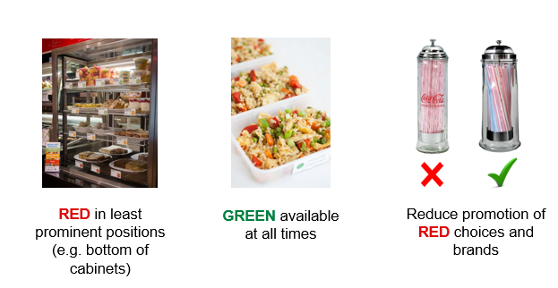
Display and promotion principles
Notes:
RED options should not be displayed in the most prominent positions in the store – e.g. at the front counter, at eye level in the drinks fridges. They should be in least prominent places
GREEN foods & drinks should be available during all trading hours
Work towards removing promotional material that features RED foods and drinks or brands strongly associated with RED options. For example, instead of having a straw dispenser branded with Coca-Cola, have a clear dispenser instead.

Slide 20
Contact the Healthy Eating Advisory Service
www.heas.health.vic.gov.au
1300 22 52 88
heas@nutritionaustralia.org
Notes:
The Healthy Eating Advisory Service is delivered by Nutrition Australia Vic Division with support from the Victorian Government. HEAS supports a variety of settings including local governments to provide and promote healthier foods and drinks.
HEAS can provide additional support and training to assist you to provide healthy food retail environments.

